Slide 1
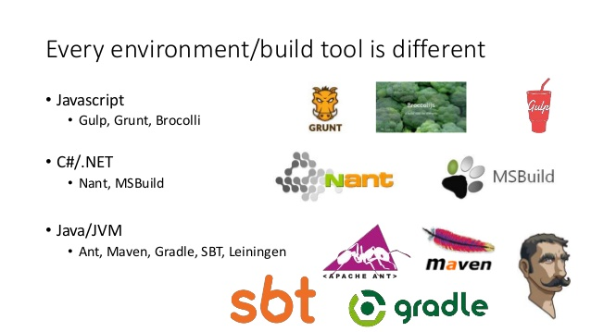

Slide 2
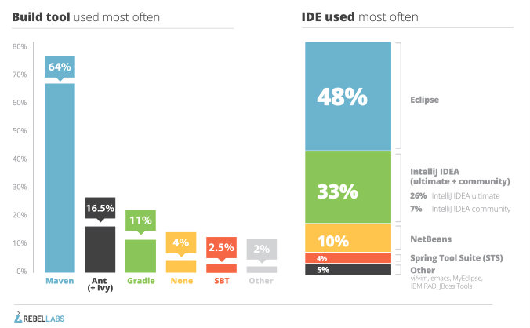

Slide 3


Slide 4


Slide 5
Maven Concepts:
Overview
Installation and Integration with Jenkins
Maven Life Cycle Phase explanation with Example
Artifacts Generation and Deployment
Java Code Deployments with Apache
Tomcat, Maven and Jenkins Integration
Maven Local and Central Rep

Slide 6

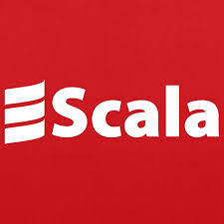

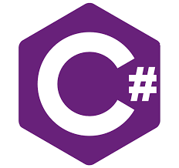
Maven Supported Languages

Slide 7
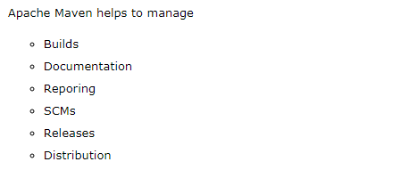

Slide 8
Maven Life Cycle

Slide 9
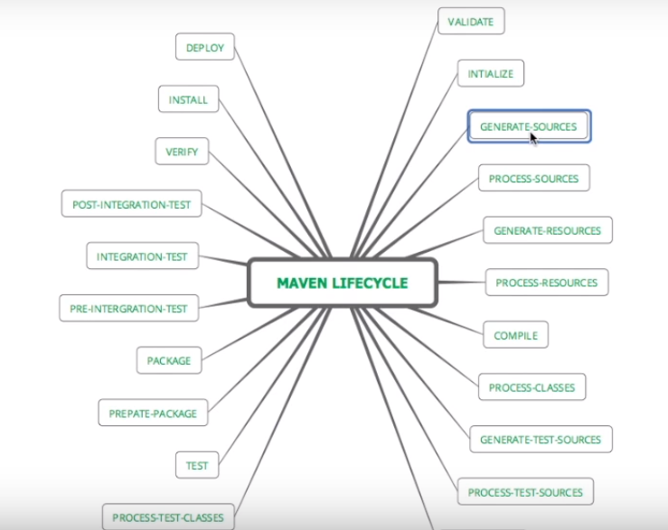

Slide 10
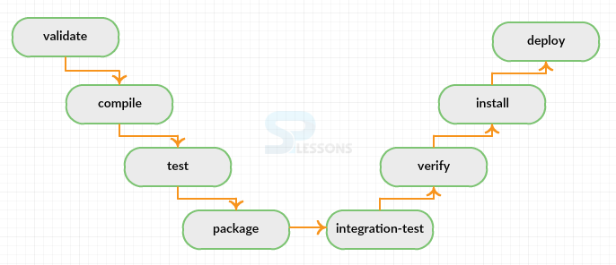

Slide 11
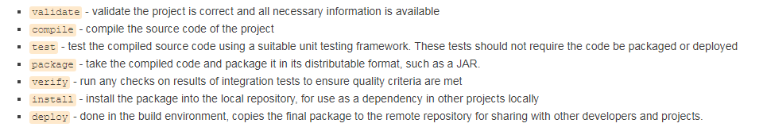
Maven Life Cycle Explanation:

Slide 12
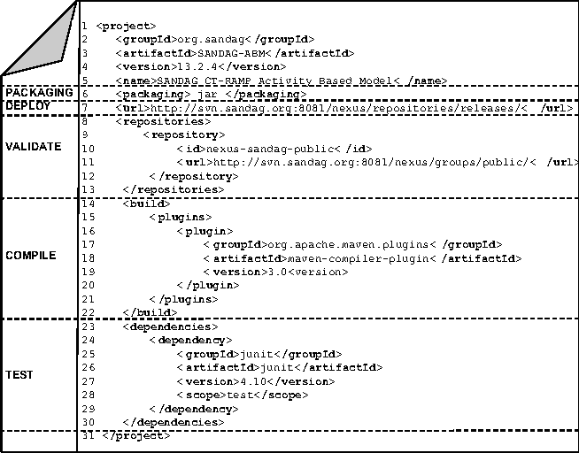

Slide 13
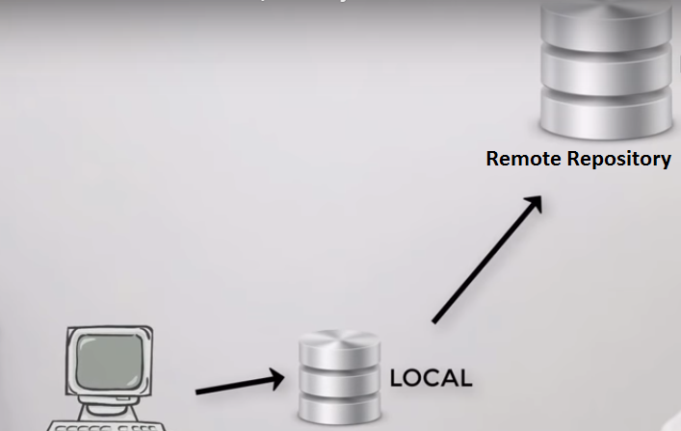

Slide 14
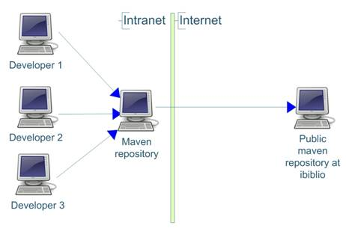

Slide 15
